Slide 1



SALES FORCASTING AND
OPTIMIZATION
Presented by : Digital Egypt Pioneers
Amit Students
11 May 2025

Slide 2

CONTENT
01
Overview
03
Exploratory Data Analysis (EDA)
04
Forecasting Model Development
05
Conclusion
06
Our Team

Slide 3


Project Overview
1
INTRODUCTION
Think of every time you bought something at a store or online — that’s retail sales in action
💡 Key Takeaways:
Sold directly to you, the end customer
Every purchase = a recorded transaction
Driven by promotions, holidays, seasons, location, and customer habits
Used for everything from forecasting and inventory planning to economic health checks

Slide 4

Project Overview
1.1
MEET THE ROSSMANN STORE SALES DATASET
Imagine having access to 1,000+ stores’ sales data across Germany — that’s what this dataset offers!
Daily sales per store
Store-specific features like type, product variety, competition distance
External signals like school & public holidays, and store closures
Time Period: Jan 2013 – July 2015
Perfect for forecasting future trends, modeling demand spikes,
and simulating real-world business decisions.

Slide 5
Project Overview
1.2
DATASET FILES OVERVIEW
train.csv
test.csv
store.csv
Our playground
Includes Store, Date, Sales, Customers, Open, Promo, StateHoliday, SchoolHoliday
The challenge
Similar to train.csv but without the Sales column
Used for prediction and submission
The secret sauce
Includes:StoreType, Assortment, CompetitionDistance, Promo2, etc.
Must be joined with train.csv and test.csv on the Store column
This dataset is more than numbers — it's a real-world business simulation, and your mission is to predict sales like a retail mastermind.
Ready to turn data into decisions?

Slide 6




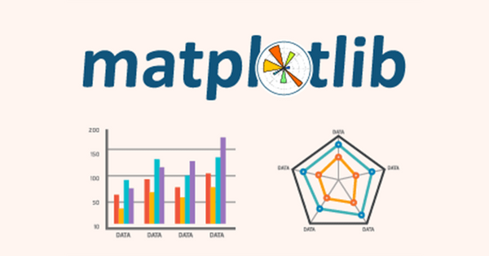

Project Overview
1.3
TOOLS & LIBRARIES

Slide 7

EXPLORATORY DATA ANALYSIS

Slide 8
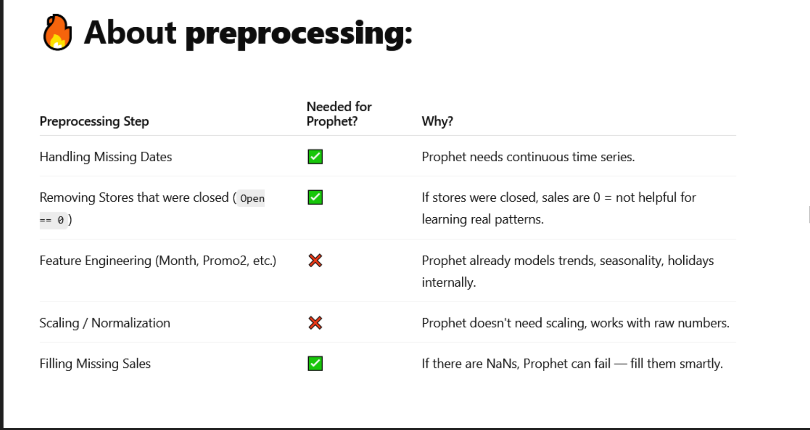

Slide 9
EXPLORATORY DATA ANALYSIS
Goal: Understand data structure, distributions, and relationships to inform modeling.
Focus on train.csv and store.csv datasets.
Insights will be grouped into:
Data Overview
Feature Engineering
Missing Values
Store Type Insights
Promotions & Sales Patterns
Correlation Analysis
SOON
2021
2022
2022
2023

Slide 10
TRAIN.CSV – OVERVIEW
Train Data Summary
Features:
Store, Date, Sales, Customers, Open, Promo, StateHoliday, SchoolHoliday
Sales = Target variable
No missing values
Only StateHoliday is categorical
Time series data ⇒ extract Year, Month, Day, WeekOfYear
~20% of data has Sales == 0
Average spend per customer ≈ €9.50/day

Slide 11

Feature Engineering
FEATURE ENGINEERING FROM DATE & SALES
Extracted:
Year, Month, Day, WeekofYear
Created:
SalesPerCustomer = Sales / Customers
ECDF used to examine distribution:
~80% of days had sales < €1000
Outliers: Sales = 0 (needs further inspection)

Slide 12
Feature Engineering
HANDLING ZEROS & CLOSED STORES
Zero Sales & Closed Store Analysis
~172,817 records (≈10%) have Open = 0 → Drop for modeling
Found open stores with Sales == 0 (only 54 cases)
Possible external factors (strikes, delivery issues)

Slide 13
STORE.CSV – OVERVIEW
Thynk Unlimited
Store Data Summary
Key Features
Missing Values:
StoreType, Assortment, CompetitionDistance, Promo2
CompetitionDistance: 3 → Impute median
CompetitionOpenSinceMonth/Year,
Promo2SinceWeek/Year,PromoInterval: 354–544 → Fill with 0 if Promo2 = 0

Slide 14

Merging Data
MERGING TRAIN & STORE DATA
Inner join on Store
Combined dataset: train_store
Enables grouped analysis by StoreType, Promo, Assortment, etc.

Slide 15
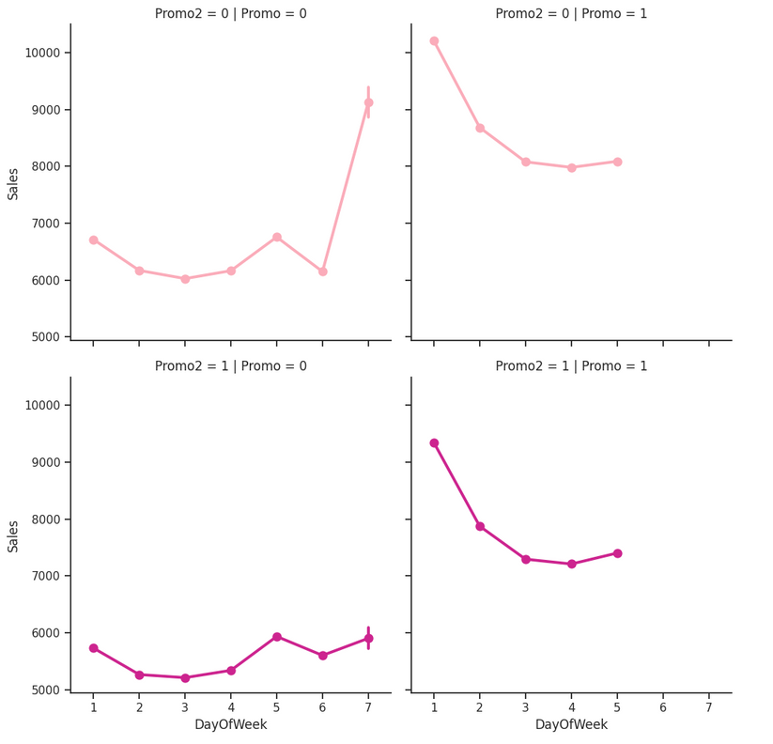
PROMOTIONS & WEEKLY SALES
PROMOTION & DAY-OF-WEEK SALES BEHAVIOR
Without Promo: Peak on Sundays
With Promo: Peak on Mondays
StoreType C: Always closed Sundays
StoreType D: Closed Sundays only Oct–Dec

Slide 16
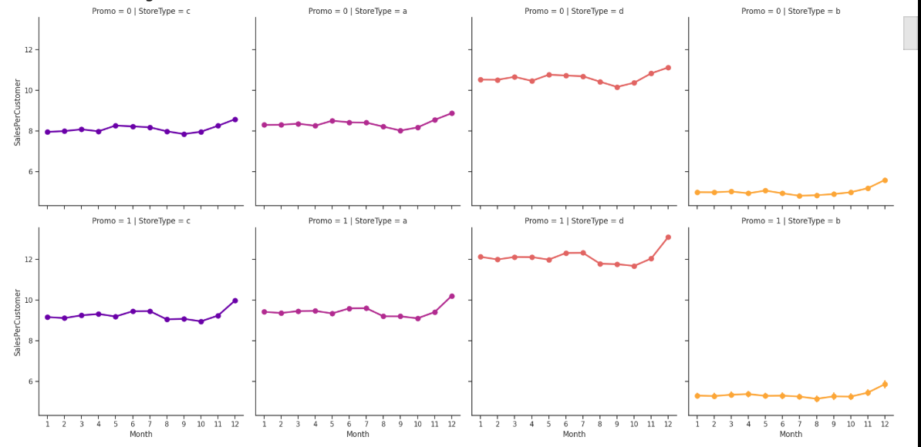
StoreType Analysis
STORETYPE & SALES DISTRIBUTION
StoreType B: Highest average sales but low count
StoreType A: Highest total sales & customer volume
StoreType D: Highest SalesPerCustomer (≈ €12 with Promo)

Slide 17
PROMO2 IMPACT ON SALES
Weak or negative correlation with Sales
Best results: Promo = 1 & Promo2 = 0
Stores with both active promotions didn’t see substantial boost
STATISTIC

Slide 18
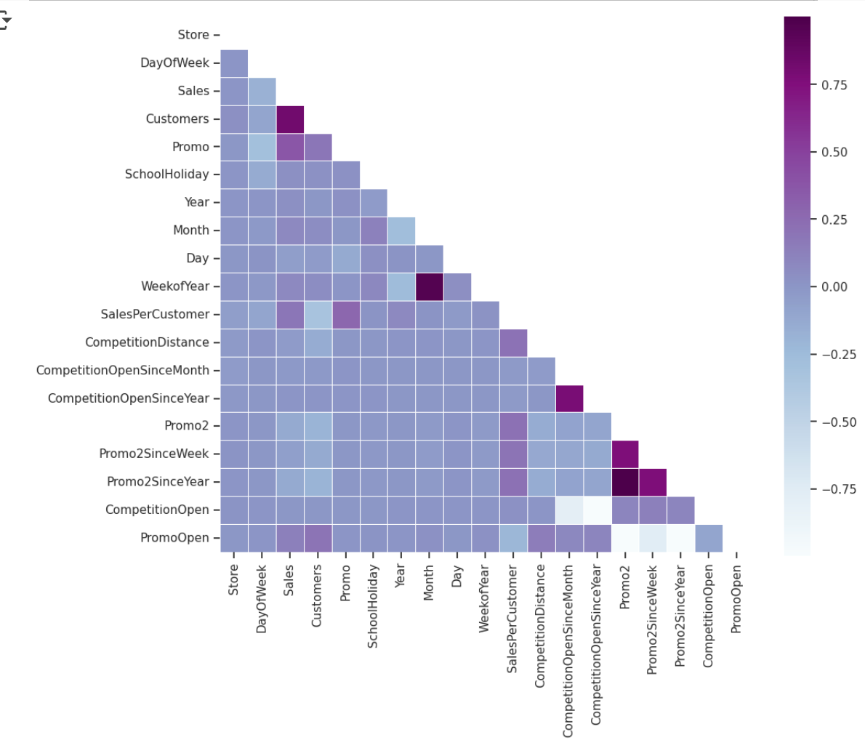
CORRELATION HEATMAP
STATISTIC
Sales ↔ Customers: Strong positive correlation
Promo ↔ Customers: Positive correlation
Promo2 ↔ Sales: Weak or negative correlation
Promo ↔ DayOfWeek: Negative correlation (less effective later in week)

Slide 19





EDA SUMMARY
StoreType A: Most customers & total sales
StoreType D: Best sales per customer
Promo campaigns drive Monday sales
Promo2 has limited effectiveness
Customer behavior varies with promotion and store type
Seasonal effect: Sales spike near Christmas

Slide 20
TIME SERIES
What Makes Time Series Special?
Observations depend on time, unlike typical regression.
Violates independence assumption.
Often includes trend and seasonality:
e.g., Sales increase during Christmas holidays.
Goal: Understand patterns to make better forecasts.

Slide 21
Why Analyze by Store Type?
STORE TYPE-LEVEL TIME SERIES ANALYSIS
Easier than analyzing each individual store.
Reveals general trends & seasonalities.
Stores analyzed:
Store #2 → Type A
Store #85 → Type B
Store #1 → Type C
Store #13 → Type D
Data is resampled weekly for clarity.

Slide 22
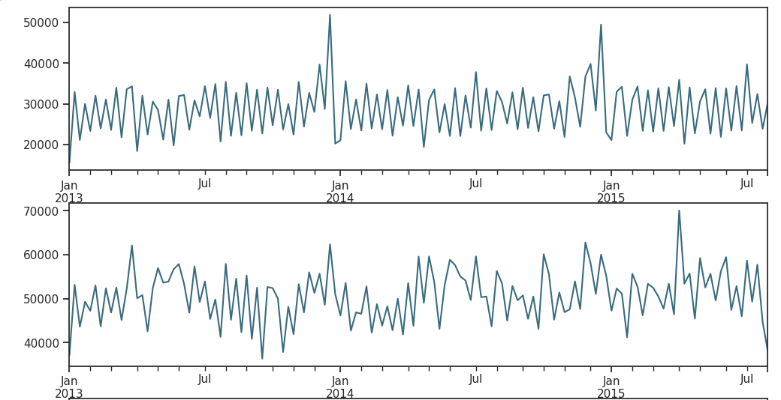
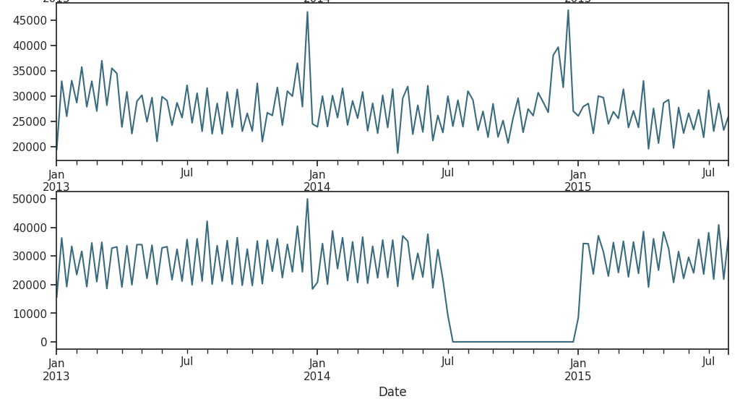
Weekly Sales Trends
WEEKLY RETAIL SALES TRENDS
a
Type A & C: Clear Christmas sales spikes.
Type D: Data missing from Jul 2014–Jan 2015 (closed stores).
Post-holiday drop observed across types.
b
c
D

Slide 23
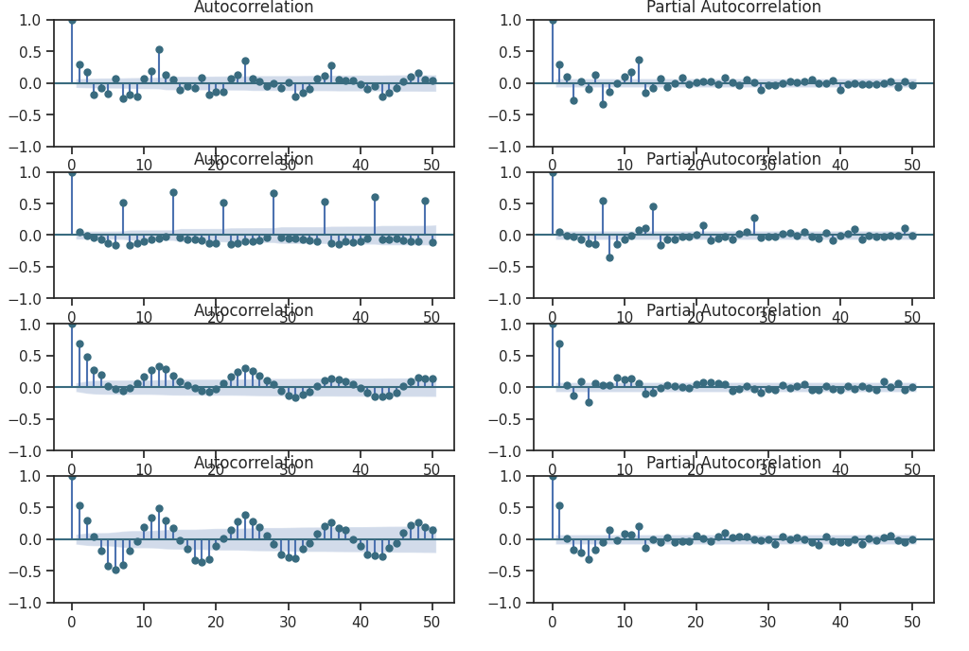
Seasonal Patterns
SEASONALITY & LAG ANALYSIS
Horizontal plots (ACF & PACF) by store type.
Common patterns:
Lag-1 autocorrelation is high → Suggests differencing.
Type A: Seasonal spikes every 12/24 lags (monthly).
Type B: Weekly spikes at lag 7, 14, 21, 28.
Type C & D: Complex correlations with adjacent lags.

Slide 24
Forecasting with Prophet
FORECASTING SALES WITH PROPHET
Prophet allows:
Trend & seasonality modeling
Holiday effects (state & school holidays)
Forecast horizon: 6 weeks (42 days) into the future
Prophet forecasts include:
Trend, weekly effect, holiday impact

Slide 25
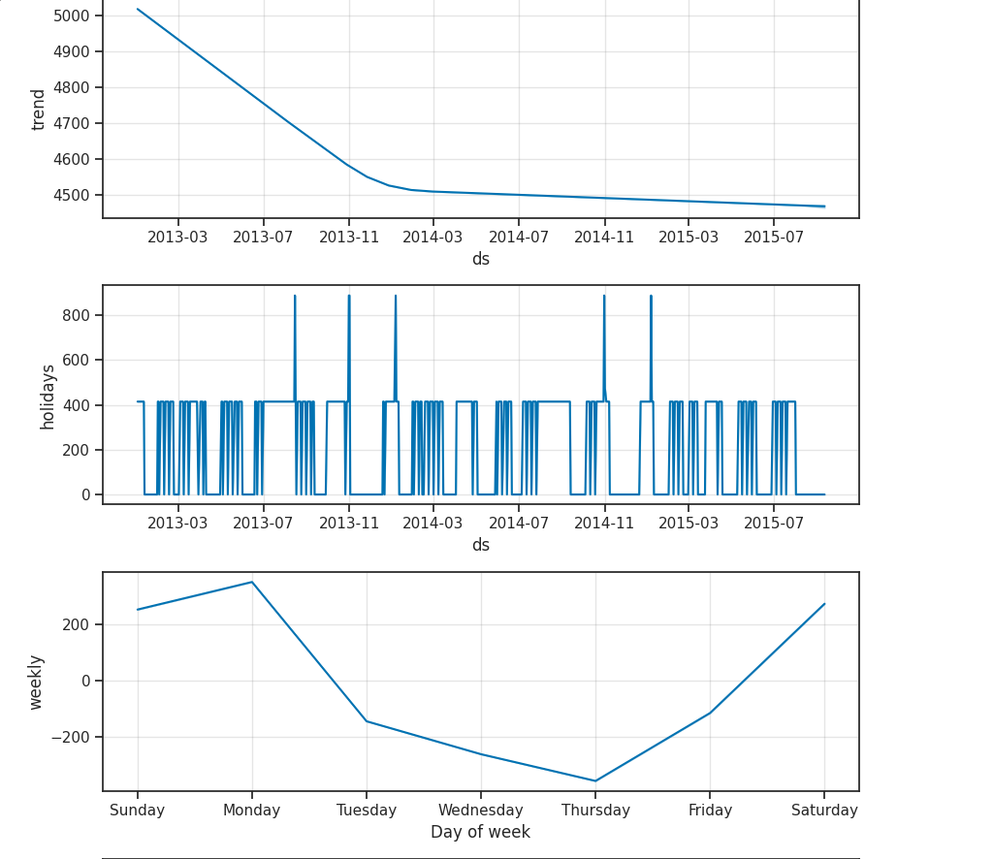
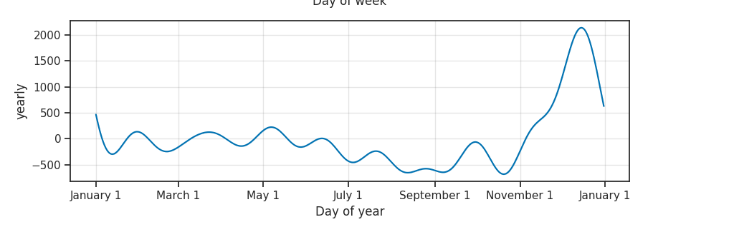
Prophet Output Analysis
PROPHET FORECAST OUTPUT HIGHLIGHTS
Store #1 shows linear decrease in sales
Weekly peak: Monday sales spike
Holiday influence: Christmas most active period
Visualizations help validate model fit & patterns

Slide 26
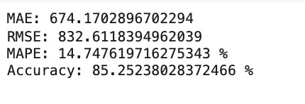
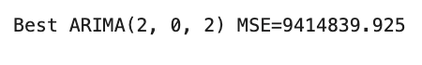
Accuracy & Evaluation
FORECAST ACCURACY EVALUATION
Used metrics:
MAE, MSE, RMSE, MAPE
Forecasts stored in 'yhat' column
Comparison: 'sales' vs 'forecastt'
Best ARIMA model MSE ≈ 9.4M (very high)

Slide 27
Why ARIMA Alone Fails
ARIMA MODEL LIMITATIONS
Rossmann Sales = Complex time series:
Trend + Seasonality
Promotions, Holidays, Competition
ARIMA without external features underperforms
Better suited: SARIMA, Prophet, XGBoost, LSTM

Slide 28
SARIMA Forecasting (Optional)
TIME SERIES WITH SARIMA (BONUS)
Captures seasonal trends
7 hyperparameters → Manual tuning needed
Requires 4–5 full seasons of data
Limited ability to handle external variables

Slide 29
Time Series Forecasting – Conclusion
KEY TAKEAWAYS
Advantages:
Accounts for time trends, seasonalities, holidays.
Prophet is intuitive and handles holidays well.
Drawbacks:
Limited handling of external interactions (Promo, Competition).
SARIMA requires extensive data & manual tuning.
ARIMA underperforms in real-world complexity.

Slide 30
OUR TEAM
Our team is a diverse blend of creative minds, strategic thinkers, and industry experts committed to propelling your business to new heights. With a passion for innovation and a collective dedication to excellence, we bring a wealth of experience and fresh perspectives to the project.
Nour Sameh
Amr Gaber
Ahmed Gamal
Ahmed khaled
Moustafa
Zeyad Tarek

Slide 31

THANK YOU
FOR YOUR ATTENTION
May 2025

